Slide 1
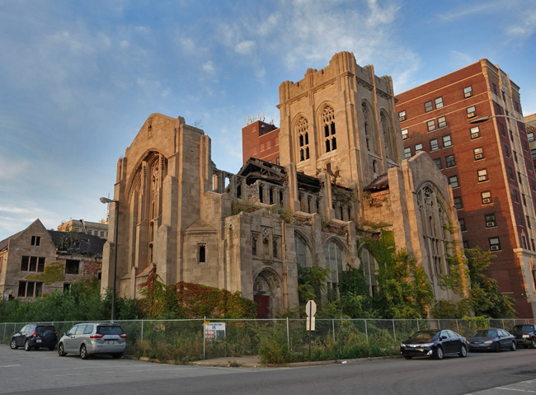

City of Gary
BROWNFIELDS
MULTIPURPOSE GRANT 2024
COMMUNITY
INVOLVEMENT
FORUM
4:00pm
NOVEMBER 1, 2023
Environmental Remediation at City United Methodist Church

Slide 2
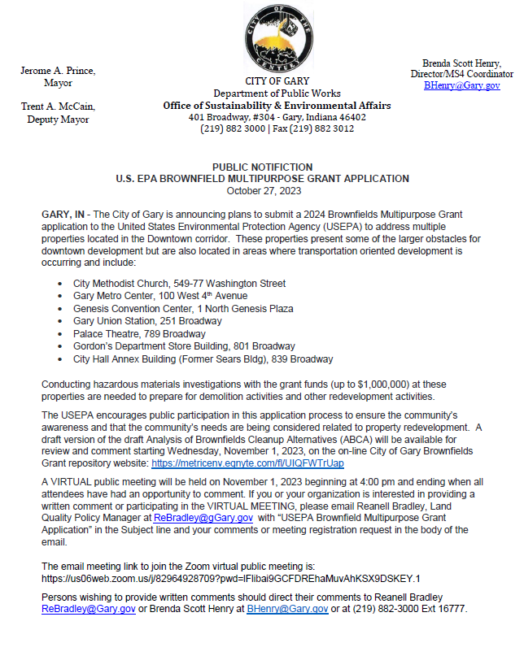
City of Gary
BROWNFIELDS MULTIPURPOSE GRANT 2024
PUBLIC NOTCE
City United Methodist Church - 2017

Slide 3
City of Gary
BROWNFIELDS MULTIPURPOSE GRANT 2024
AGENDA
Introductions and Purpose of Meeting
Importance of Redevelopment
City of Gary Scope of Work for Brownfields Multipurpose Grant
Investigative History for Sites of Interest
Sites of Interest
Confirmed Environmental Concerns
Next Steps
Questions and Answers?
City United Methodist Church - 2017

Slide 4
City of Gary
BROWNFIELDS MULTIPURPOSE GRANT 2024
Introductions
Ms. Brenda Scott Henry
Director, Office of Sustainability and Environmental Affairs
Ms. Kennita Jones
Senior Project Geologist, Metric Environmental
Ms. Karla McDonald, CHMM
Senior Environmental Manager, Metric Environmental
City United Methodist Church - 2017

Slide 5
City of Gary
BROWNFIELDS MULTIPURPOSE GRANT 2024
Purpose of the Meeting
To connect with the community to discuss and address the potential redevelopment and remediation of underutilized properties within the community.
City United Methodist Church - 2017

Slide 6
City of Gary
BROWNFIELDS MULTIPURPOSE GRANT 2024
Importance of Brownfields redevelopment
  Brownfields redevelopment offers a host of benefits ranging from economic & environmental to social and cultural, making the redevelopment of brownfields an essential component of sustainable and responsible land use planning. Examples are as follows:
    Land conservation/infrastructure optimization
    Economic revitalization
    Environmental Remediation
    Urban Renewal
    Historic Preservation
City United Methodist Church - 2017

Slide 7
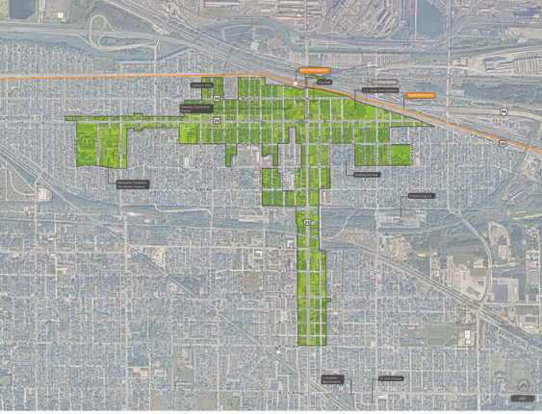
City of Gary
BROWNFIELDS MULTIPURPOSE GRANT 2024
Transit Development District
The Gary Metro TDD (315.5 acres) benefits from the momentum to revitalize Downtown Gary through targeted infrastructure improvements, blight elimination, and community-focused redevelopment in partnership with state, regional, and local partners.
A revitalized Gary Metro Station block has the potential to create immense opportunity or equitable transit-oriented development throughout Downtown Gary.
The resulting TDD boundary for the Gary Metro TDD station area focuses on three future investment strategies: Station as a Catalyst, Improving Station Access, Redefining Broadway, and Property Control. The redevelopment of Gary Metro Center and its neighboring sites will anchor proposed future development for downtown Gary

Slide 8
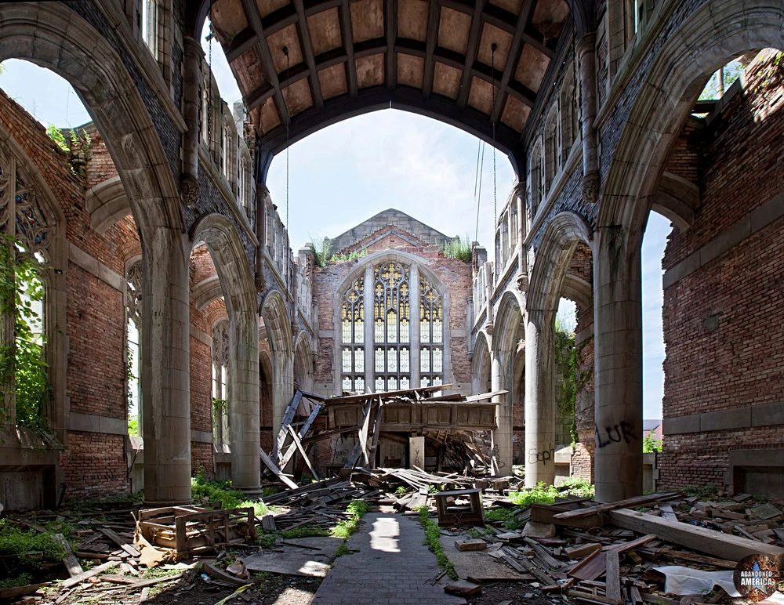
City of Gary
BROWNFIELDS MULTIPURPOSE GRANT 2024
Understanding Brownfields
  Types of Brownfields
    Industrial Brownfields
    Commercial Brownfields
    Residential Brownfields
    Landfill and Dump Sites
    Transportation & Infrastructure
    Brownfields
    Waterfront & Port Brownfields
City United Methodist Church - 2017

Slide 9

City of Gary
BROWNFIELDS MULTIPURPOSE GRANT 2024
Financing Brownfields Redevelopment
  Federal and State Funding Programs
  Public-Private Partnerships
  Grants & Loans
City United Methodist Church - 2017

Slide 10
City of Gary
BROWNFIELDS MULTIPURPOSE GRANT 2024
Scope of Work
The City of Gary is applying for a Brownfields Multipurpose grant from the US Environmental Protection Agency (EPA) in the amount of $1,000,000. The grant will be used to inventory, assess and cleanup environmental concerns identified at sites of interest.
Environmental health and safety concerns potentially present at each site:
  Asbestos Containing Materials ACM) and Lead Based Paints
  Possible soil, groundwater, and indoor air contamination associated with industries in the area (ex. Drycleaners, auto repair and other industrial operations).
  Hazardous materials (building materials, or abandoned or dumped materials)
City United Methodist Church - 2017

Slide 11
City of Gary
BROWNFIELDS MULTIPURPOSE GRANT 2024
History of work completed within the City of Gary for potential redevelopment
    2012 – Phase I Environmental Site Assessment of City Methodist Church
    2017 – Phase II Subsurface Investigation & Limited Asbestos Inspection of City Methodist Church
    2018 - Transit Oriented Development (TOD) Screening of 90 parcels within the I-65 Redevelopment Area
    2023 – Transaction Screening Screening of 26 parcels within the Northlake Brownfields Area (I-90 south along Broadway to West 15th Avenue and travels to the west along West 15th Avenue to the Chase Street intersection and along Chase Street traveling north to I-90.)
City United Methodist Church - 2017

Slide 12
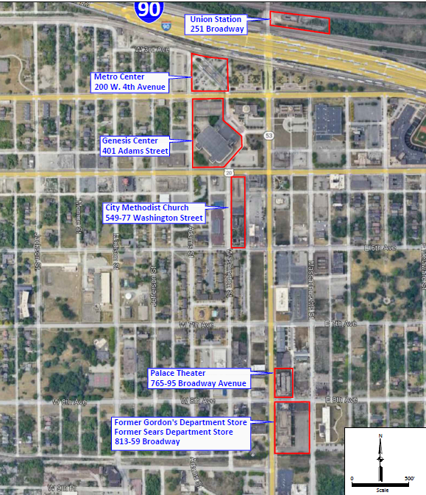
City of Gary
BROWNFIELDS MULTIPURPOSE GRANT 2024
Sites of Interest
  Union Station – 251 Broadway
  Adam Benjamin Metro Center – 200 W. 4th Avenue
  Genesis Center – 401 Adams Street
  City Methodist Church – 549-77 Washington Street
  Palace Theater – 765-95 Broadway
  Former Gordon’s / Sears Department Store – 813-59 Broadway

Slide 13
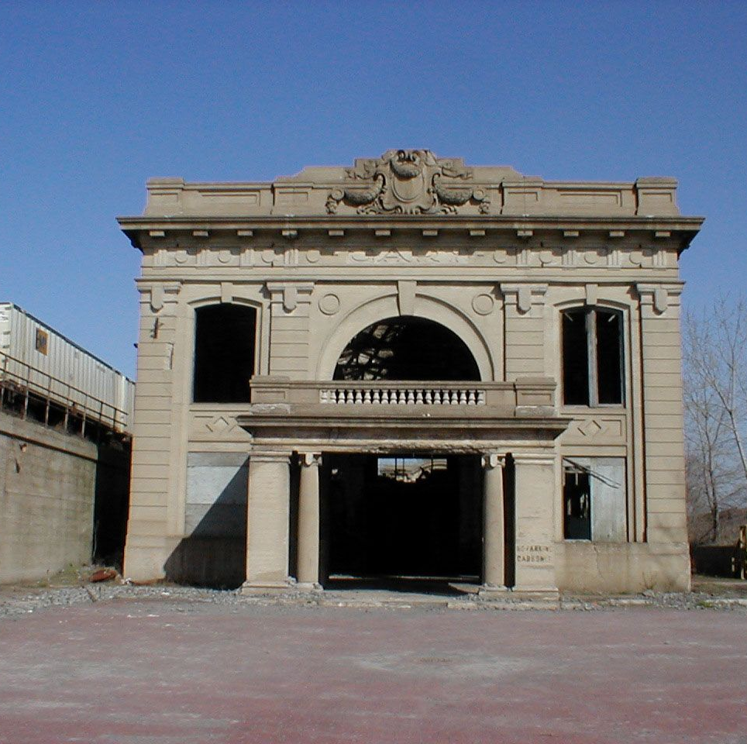
City of Gary
BROWNFIELDS MULTIPURPOSE GRANT 2024
Union Station
    251 Broadway
  Constructed in 1910
  Officially closed in 1950
  Filming location of 1951 movie “Appointment with Danger”
  Listed on National Register of Historic Places in 2019
  Proposed redevelopment underway as a multi-purpose technology and business hub (Fiber Smart House). The Fiber Smart House will provide technology training and education to local residents.

Slide 14
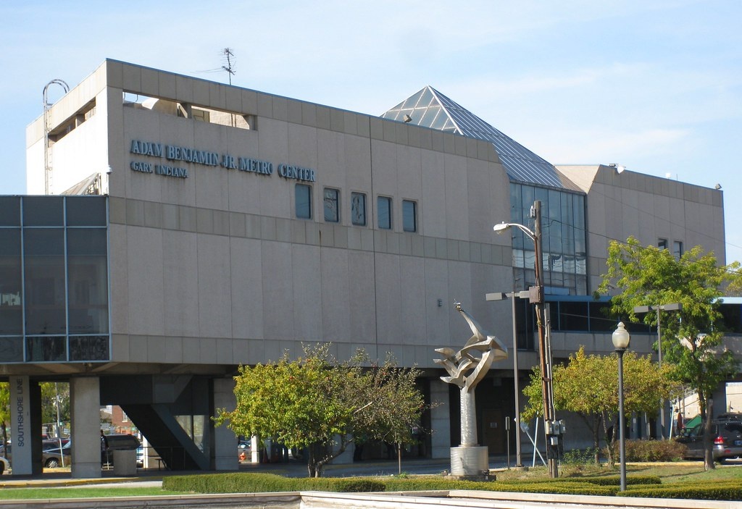
City of Gary
BROWNFIELDS MULTIPURPOSE GRANT 2024
Adam Benjamin Metro Center
    200 W. 4th Avenue
  Constructed in 1984
  Downtown Gary Station on South Shore Line
  One of three (3) NICTD electric train stations in Gary
  Serves as a stop for Greyhound Lines
  One of three (3) NICTD electric train stations in Gary

Slide 15
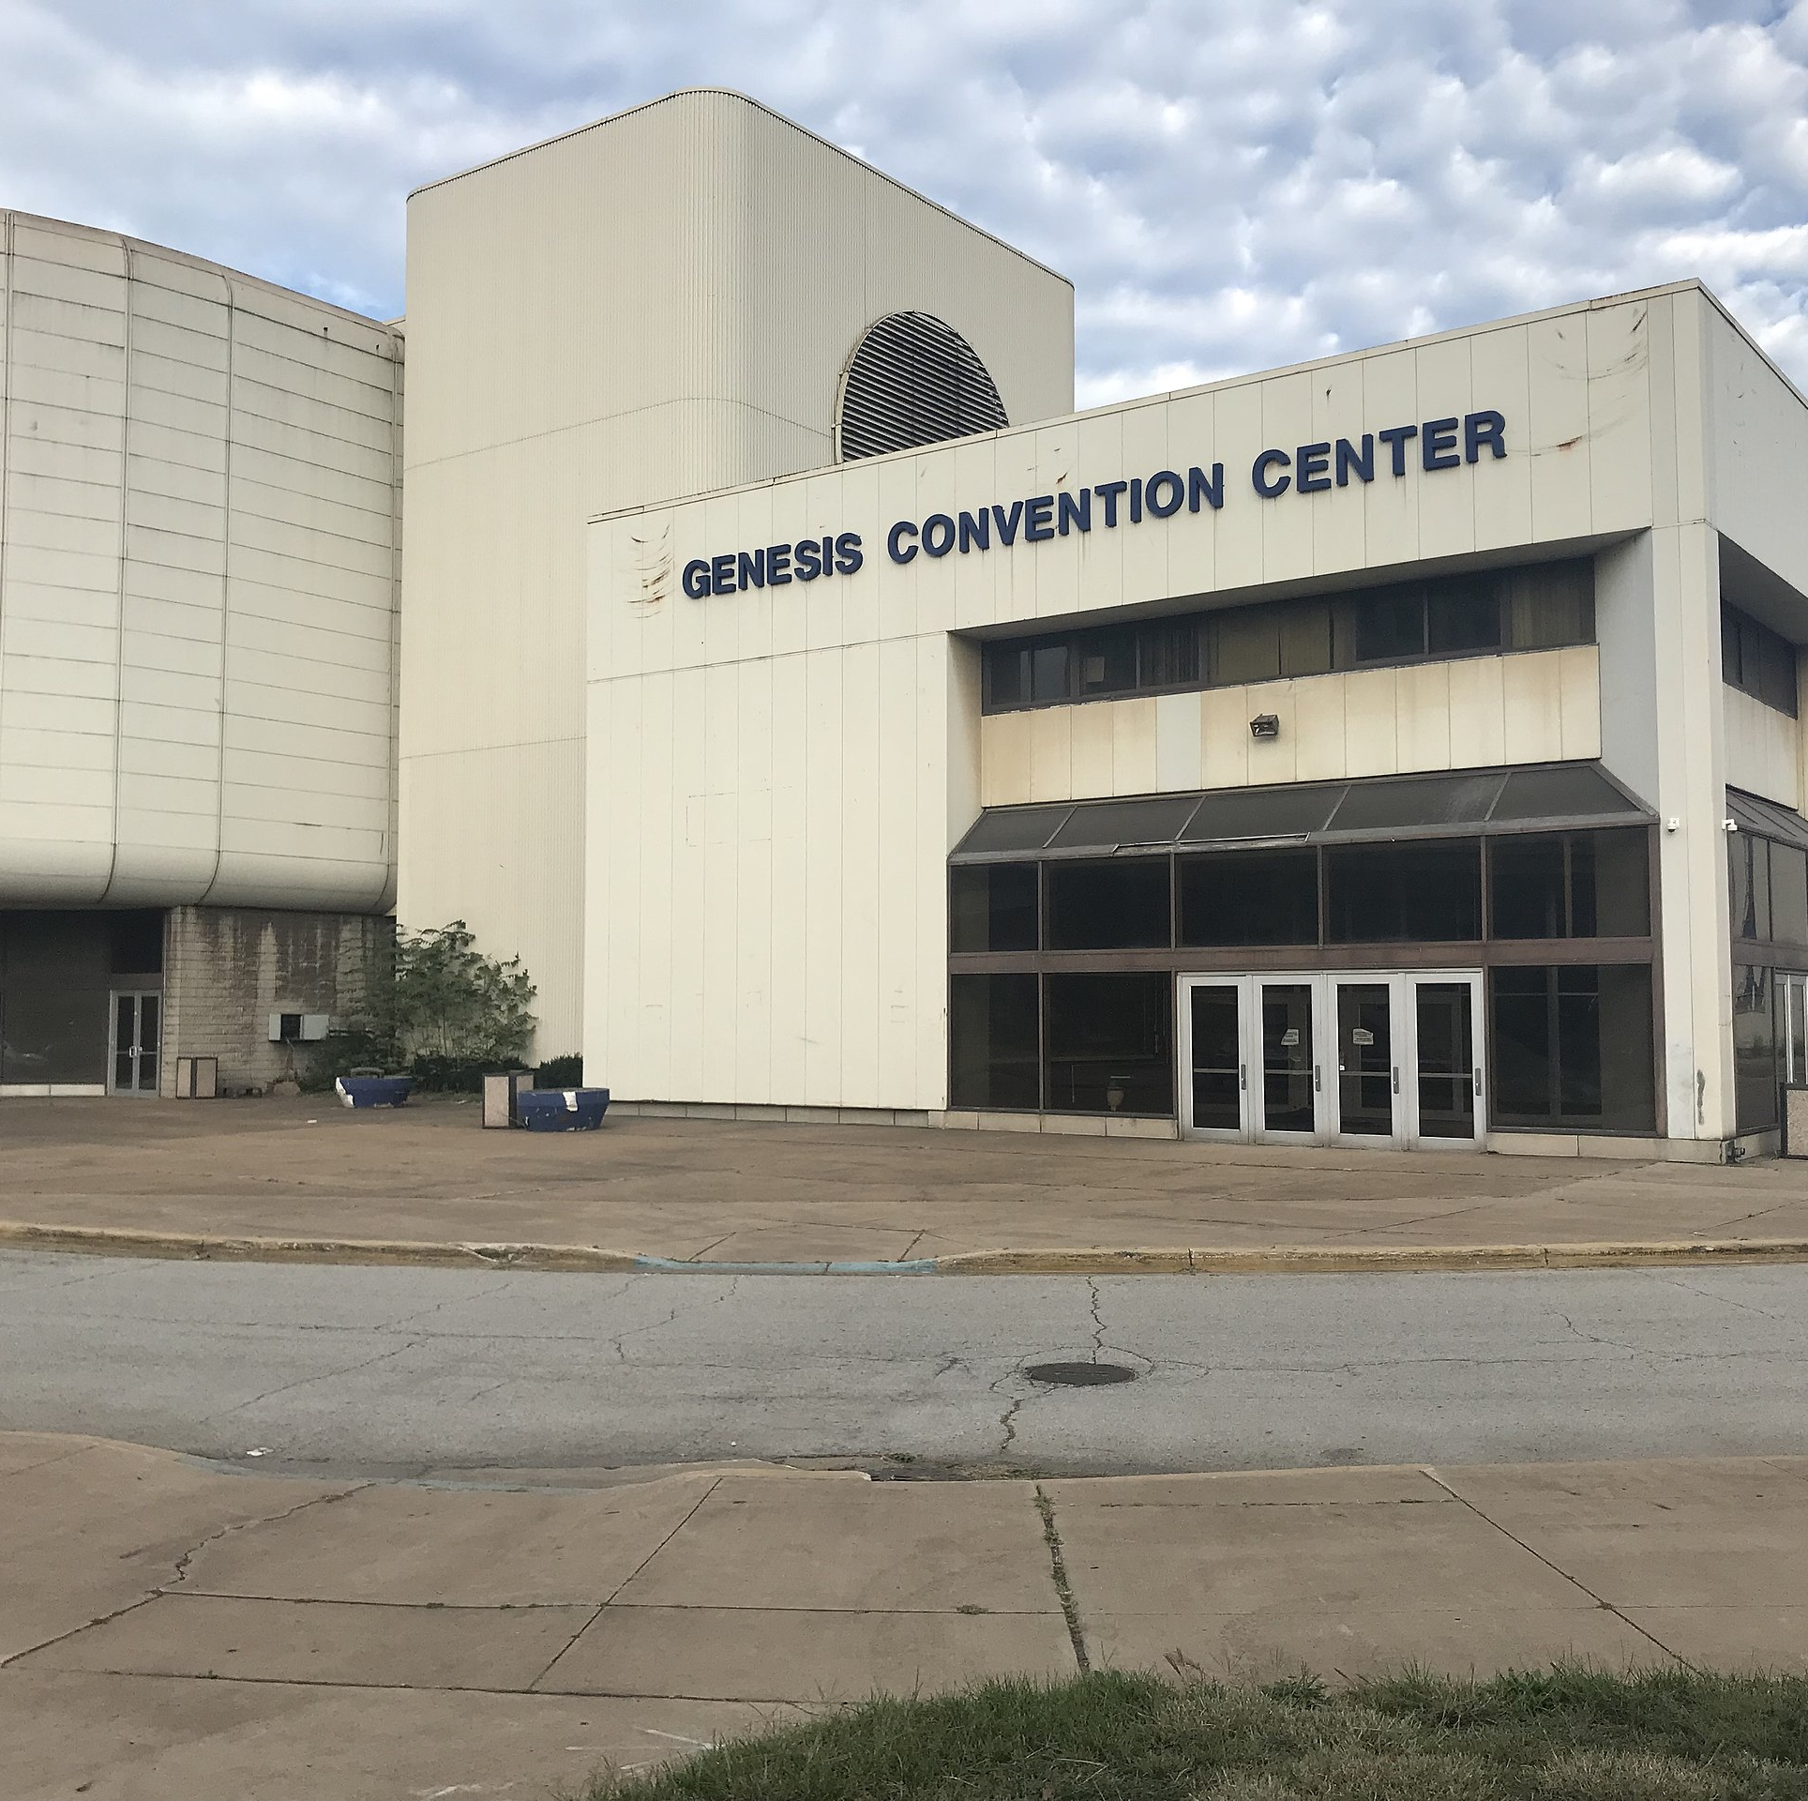
City of Gary
BROWNFIELDS MULTIPURPOSE GRANT 2024
Genesis Center
    401 Adams Street
  Constructed in 1981
  Closed in 2020
  Hosted many sporting, social and concert events

Slide 16
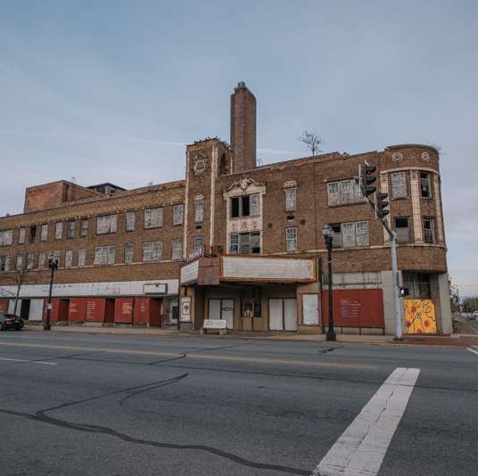
City of Gary
BROWNFIELDS MULTIPURPOSE GRANT 2024
Palace Theatre
    765-95 Broadway
  Constructed in 1925
  Could accommodate up to 3,000 guests on multiple levels.
  Closed and reopened several times between 1972 and the 1980s.
  Short listed for demolition in 2004

Slide 17
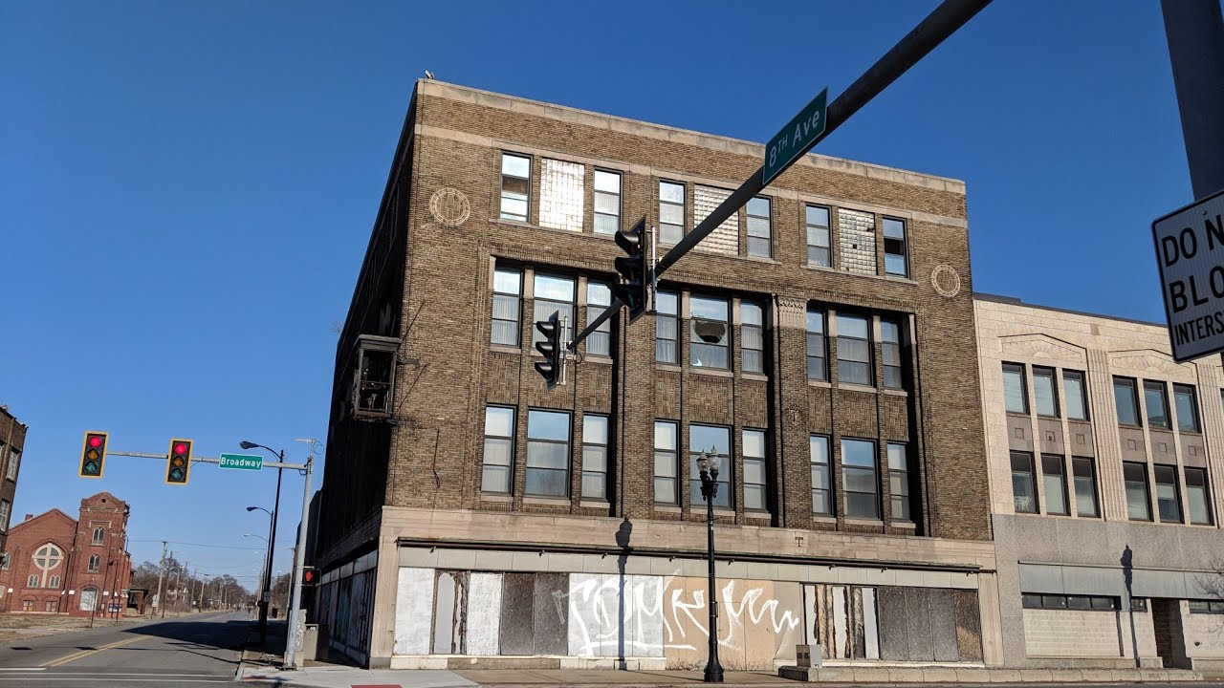
City of Gary
BROWNFIELDS MULTIPURPOSE GRANT 2024
Former Gordons/Sears Department Store
    813-59 Broadway
  Constructed in 1923
  Opened as the Gordon & Sons Department Store in 1939. Department store closed September 1972.
  Adjoining Sears Roebuck & Company Building opened in 1929 and closed in 1974.

Slide 18
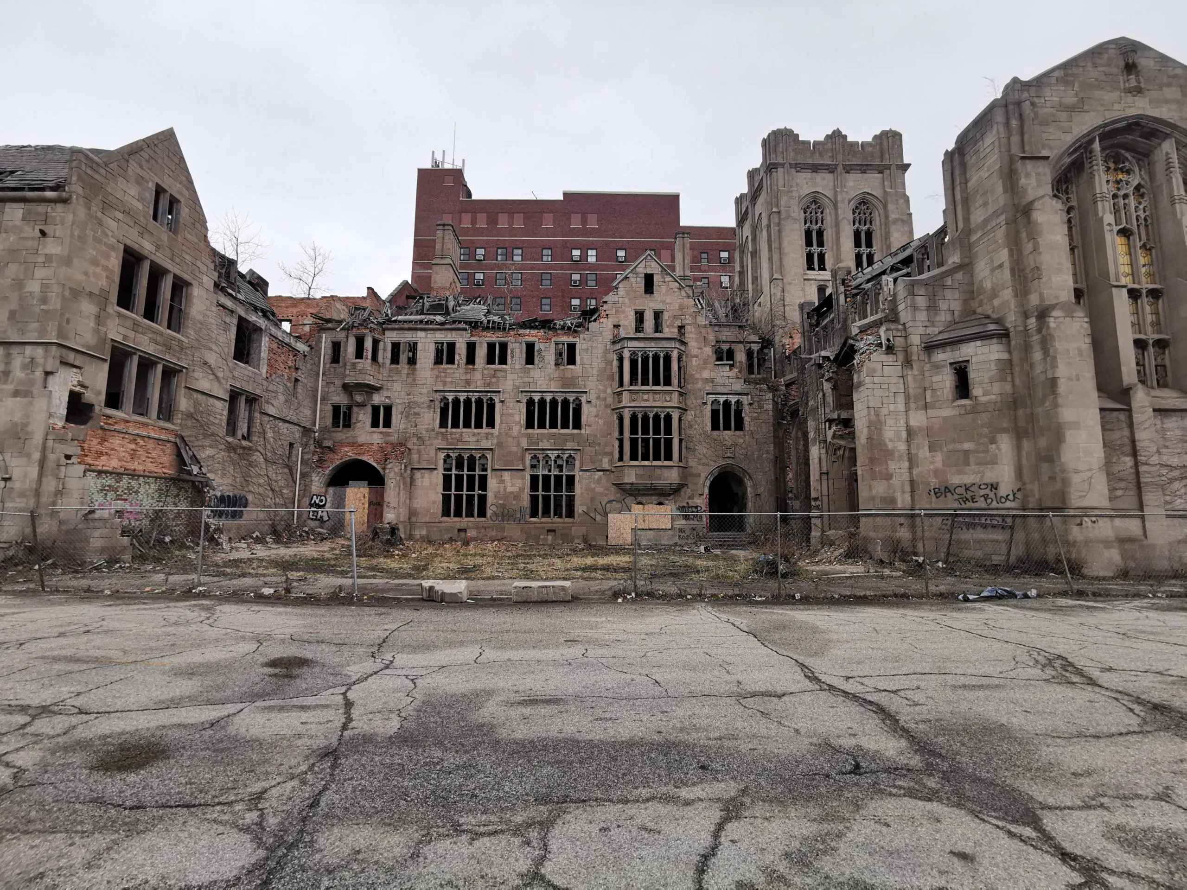
City of Gary
BROWNFIELDS MULTIPURPOSE GRANT 2024
City Methodist Church
    549-77 Washington Street
  Constructed in 1926
  First Service October 3, 1926
  Closed in 1975
  Last Service October 5, 1975
  Film location for “Soul Survivors”, “A Nightmare on Elm Street”, “Transformers: Dark of the Moon” and others.
  Proposed redevelopment as a ruins garden

Slide 19
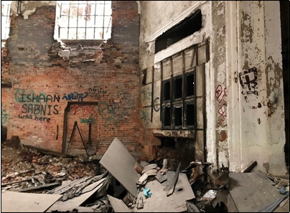
City of Gary
BROWNFIELDS MULTIPURPOSE GRANT 2024
City Methodist Church Confirmed Environmental Concerns
  Structural Issues

Slide 20
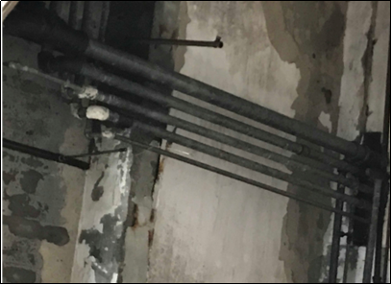
City of Gary
BROWNFIELDS MULTIPURPOSE GRANT 2024
City Methodist Church Confirmed Environmental Concerns
  Asbestos and Flooding Issues

Slide 21
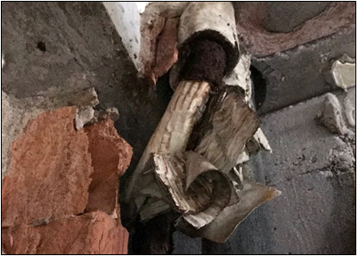
City of Gary
BROWNFIELDS MULTIPURPOSE GRANT 2024
City Methodist Church Confirmed Environmental Concerns
  Asbestos Containing Materials

Slide 22
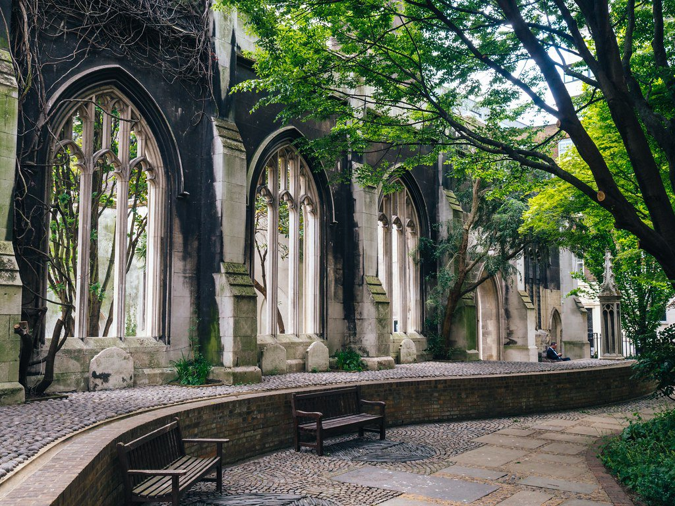
City of Gary
BROWNFIELDS MULTIPURPOSE GRANT 2024
Next Steps for Redevelopment
Grant Application & Award (Spring 2024)
Continue Identifying & Prioritizing Sites of Interest
Conduct Site Assessments on Top Prioritized Sites
Remediate/Address Environmental Concerns Identified at Prioritized Sites
Secure Project Financing for Redevelopment
City United Methodist Church - 2017

Slide 23

City of Gary
BROWNFIELDS MULTIPURPOSE GRANT 2024
Questions and Answers?
City United Methodist Church - 2017

Slide 24
City of Gary
BROWNFIELDS MULTIPURPOSE GRANT 2024
Link for Survey Comments
https://qfreeaccountssjc1.az1.qualtrics.com/jfe/form/SV_dbNDPNRTz2LSdQG
City United Methodist Church - 2017

Slide 25
City of Gary
BROWNFIELDS MULTIPURPOSE GRANT 2024
CONTACT
Ms. Brenda Scott Henry
Director
Office of Sustainability and Environmental Affairs
(219) 882-3000
BHenry@gary.gov
City United Methodist Church - 2017

